Slide 1
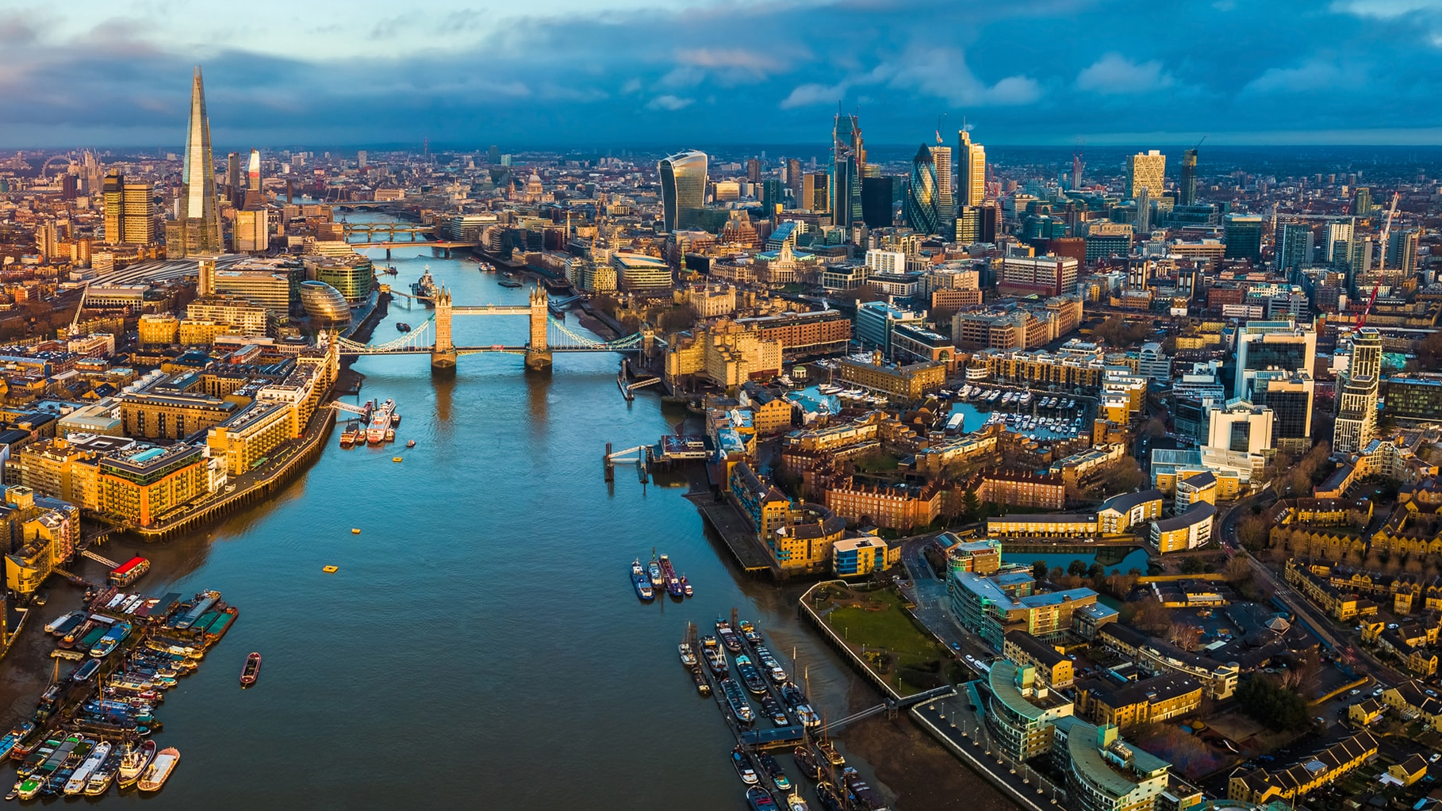
Uncovering the Popular Locations in London
Chayapod Beokhaimook
Jan 10, 2021

Slide 2
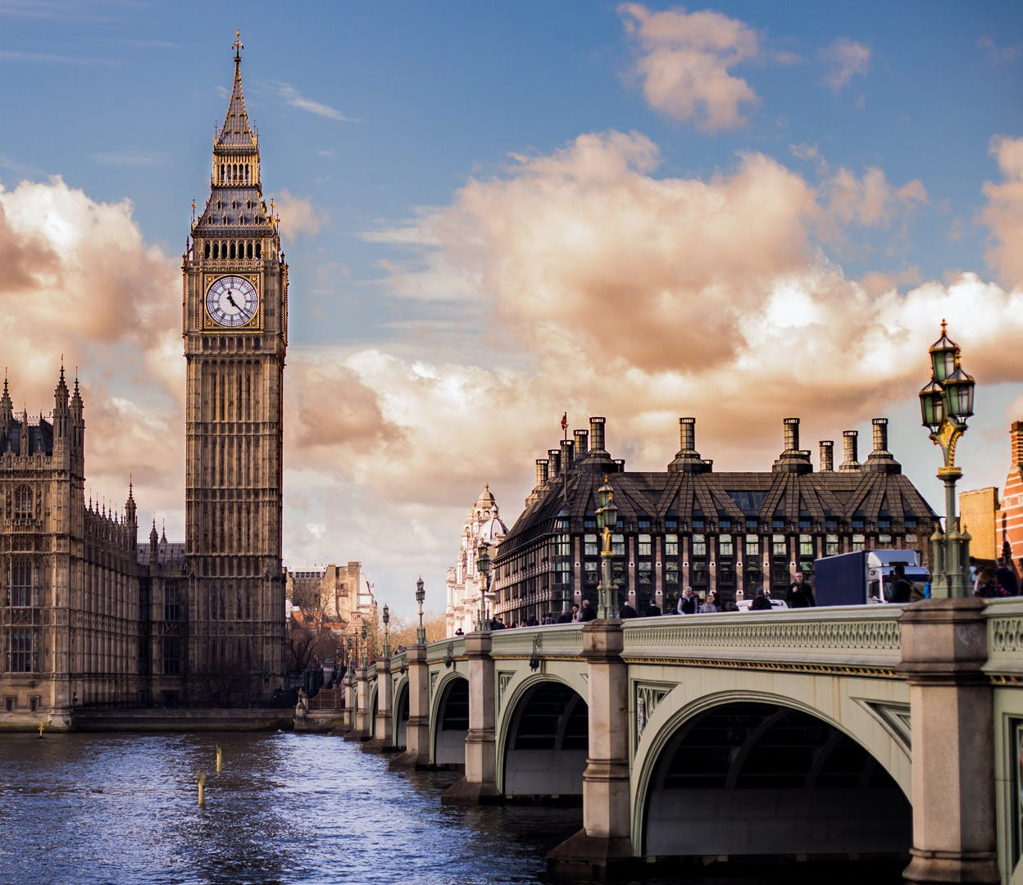
Outline
Introduction
Business Problem
Data Description
Methodology
Gathering Data
Visualization of London
Grouping Venues
Results and Discussions
Conclusions

Slide 3
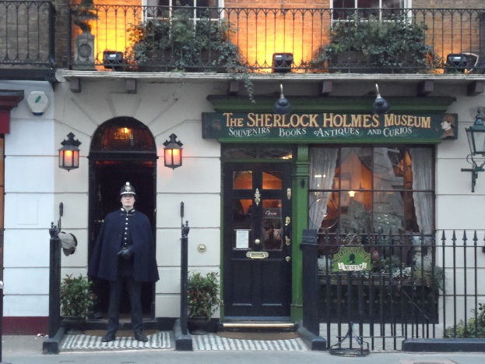
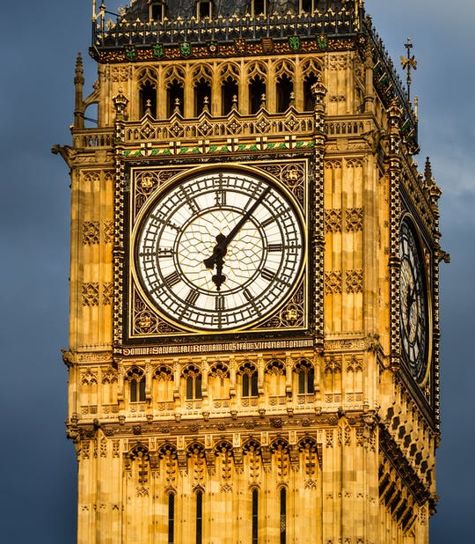
Introduction
London is popular among travelers!
Big Ben, Hyde Park, Sherlock Holmes Museum, etc.
How do you get the most from visiting London??

Slide 4
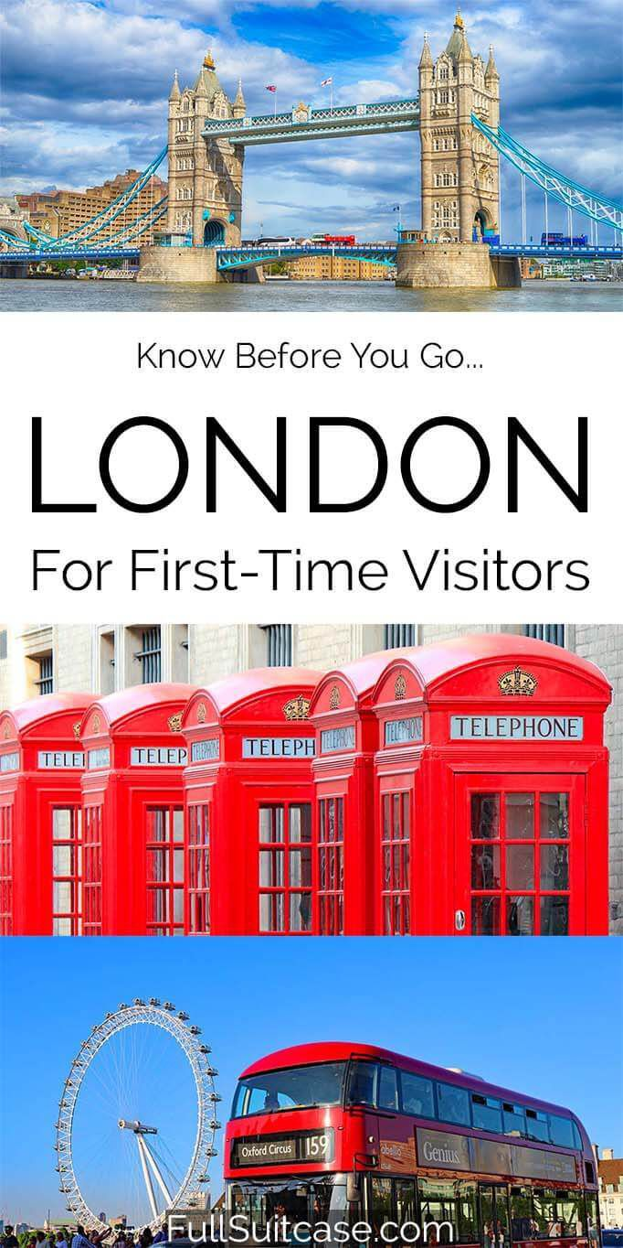
Business Problem
Help travelers plan their trip efficiently based on their likings
Help immigrants find the place where they can fit in
Help investors and stakeholders make informed decisions when starting a business
Ex. introducing Middle Eastern food in the neighborhood where there is no such restaurant

Slide 5
Data Description
Wikipedia
neighborhood, borough, and postal codes
ArcGIS API
latitude and longitude
Foursquare API
Venues and venue category
Combining the data from these sources and cluster them based on venue category

Slide 6

Methodology
3 Main Steps:
Gather and clean the required data of London
Plot the map to show the neighborhoods being considered
Build our model by clustering all of the similar neighborhoods together and visualize the clusters

Slide 7
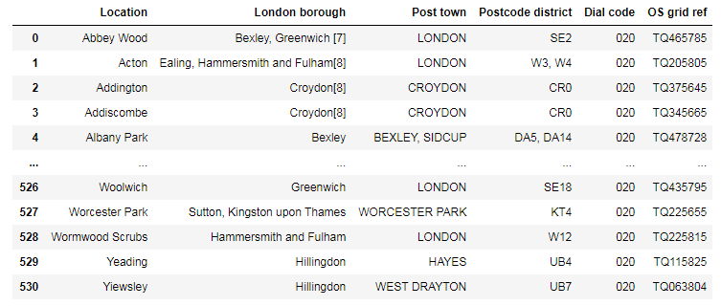
Gathering + Cleaning Data
Gather the data from Wikipedia and get rid of the irrelevant columns

Slide 8
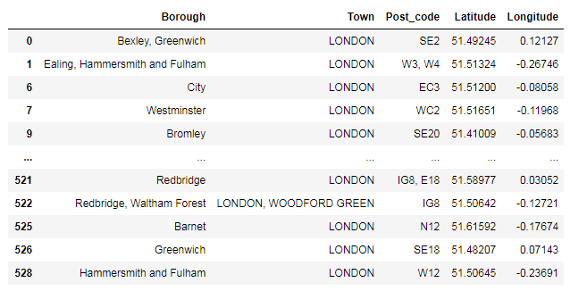
Gathering + Cleaning Data
Append the latitudes and longitudes from ArcGIS API

Slide 9
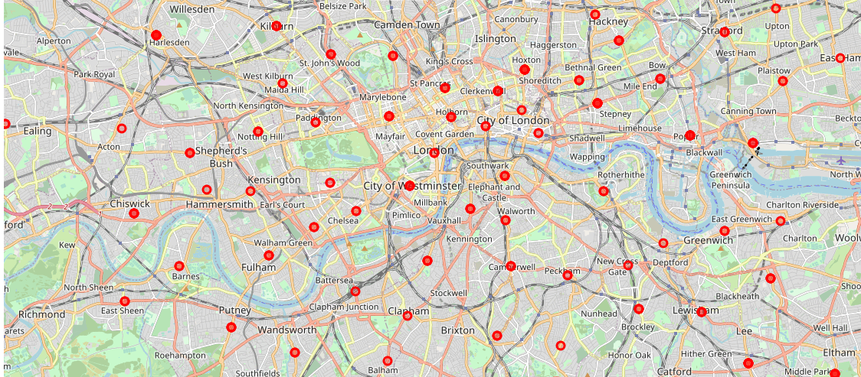
Visualizing London
With folium package

Slide 10
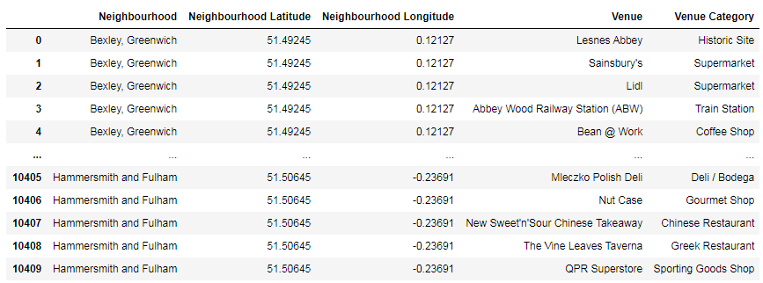
Integrating Foursquare API
Query the venues and venue category from Foursquare API

Slide 11
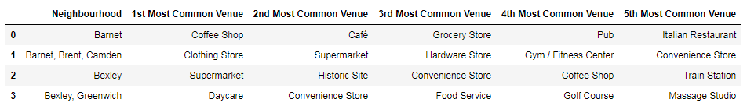
Grouping Venue Categories
There are many venues, so we pick the 5 most popular venues in each neighborhood to analyze

Slide 12
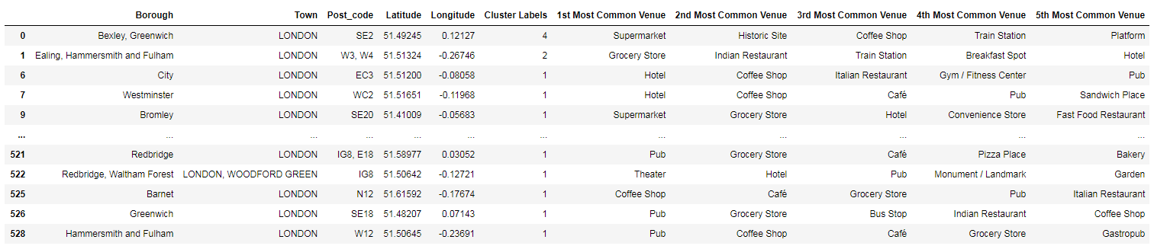
Apply K-Means Clustering Model
We use 5 clusters to separate these neighborhoods

Slide 13
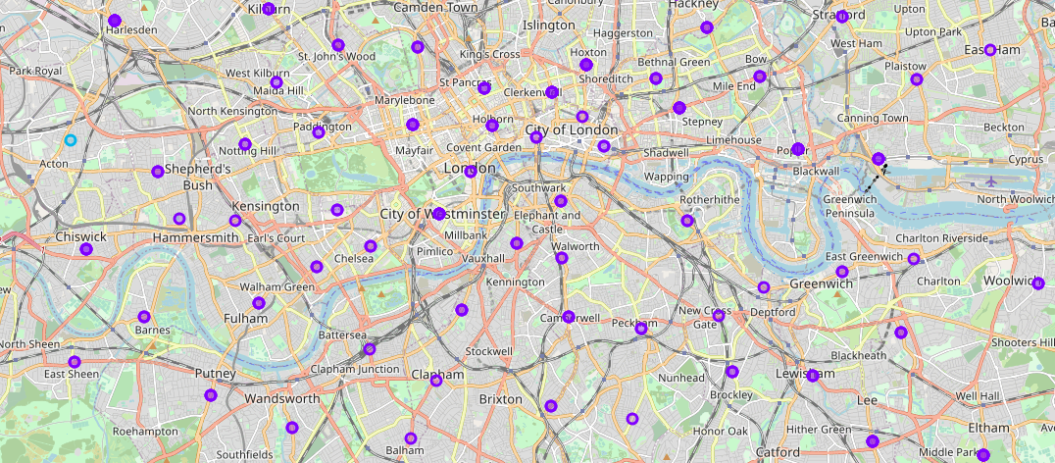
Visualizing the clusters!

Slide 14

Results and Discussions
A multicultural place!
It has a lot to offer for all kinds of people
The clusters aren’t based on locations, so it’s nice to see that we can have multiple experiences (shown by different clusters) within the near vicinity
Pick the areas you like!

Slide 15
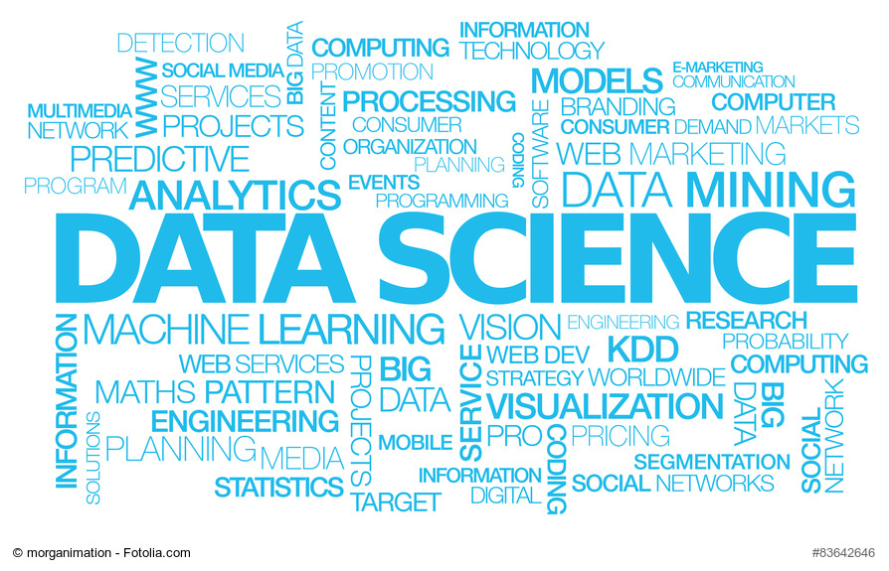
Conclusions
We can apply K-means to London
Data science offers another perspective of London, which is beneficial to visitors, investors, stakeholders, etc.
You can have a variety of experience within a couple neighborhoods!

